Slide 1
Which Theory Best Explains Human Behavior?
Psychoanalytic Theory?
Humanistic Theory?
Eastern and Native Cultures?
Behavior Theory?
Social Learning Theory?
Trait/Type Theory?

Slide 2
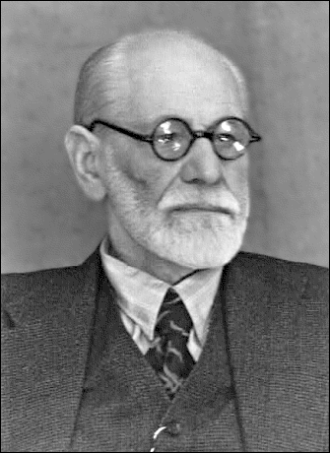
Psychoanalytic Theory
Freud asserts we are motivated by psychosexual forces
Childhood experiences and unconscious motivations determine our adult thoughts and behaviors.
We are captives of our biological and environmental forces.
The 3 personalities in a person are the id, ego, and superego.
Id - the deep unknown force inside us wanting pleasure.
Superego – the parental voice and values that govern thought.
Ego – the mediating manager.

Slide 3
Psychoanalytic Theory
Carl Jung – Our personality is decided by the past and what we hope to become. He gave a greater role to the ego.
Eric Erikson – There are 8 stages of psycho-social forces that motivate us and determine if we grow or not.
Trust vs. Mistrust
Autonomy vs. Shame
Initiative vs. Guilt
Industry vs. Inferiority
5. Identity vs. role confusion
6. Intimacy vs. Isolation
7.Generativity vs.Stagnation
8. Integrity vs. Despair
These stages, if satisfied, move us to the next stage or we will stagnate and live in misery if we don’t satisfy them.

Slide 4
Humanistic Theory
Carl Rogers – People have at their deepest core a positive goodness and will express that when accepted and trusted.
Abraham Maslow – Growth is not automatic because people are motivated to act only when a set of lower needs are satisfied.
Rollo May – The past doesn’t determine the present or the future—we have freedom of choice. Take responsibility.
Alfred Adler – Self-actualization only occurs when accompanied within one’s social group and support is available.

Slide 5

Eastern and Native Cultures
If you enhance the well-being of the group through unification, you will have individual well-being.
As long as harmony in the group occurs, self-actualization is not needed.

Slide 6
Behavior Theory
We behave the way we do because we were reinforced at a young age to do so through rewards and punishments.
The environment is the biggest factor in changing behavior, not will.

Slide 7
Social Learning Theory
People are motivated by a) how they value and need a goal b) their expectation of achieving the goal.
One’s judgments, beliefs, and expectations predict behavior more than anything.

Slide 8
Trait/Type Theory
Types are composed of traits, which in turn are comprised of numerous habits like extroversion, optimism, carefreeness, impulsivity, moody, easygoing, etc.
Personality traits and types come from both heredity and childhood experiences.

